Slide 1
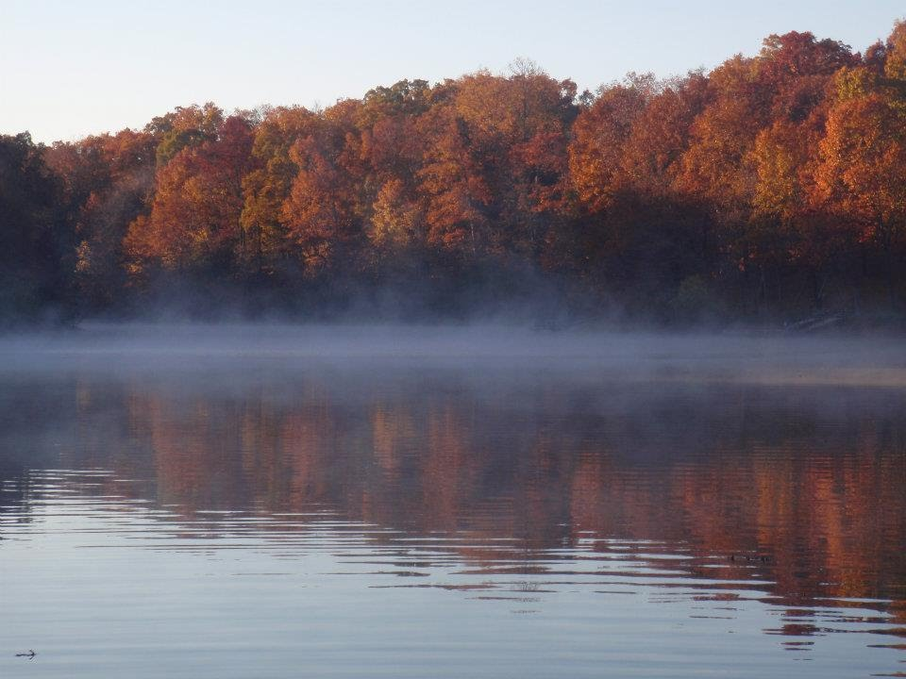
What is Limnology?

Slide 2
Limnology Defined
Derived from Greek word “limnos”, which means lake
Limnology is the study of lakes, river, and wetlands as systems (Kalff 2002)
… the oceanography of lakes (Forel 1800s)
… the study of the functional relationships and productivity of freshwater communities as they are regulated by their physical, chemical, and biological environments (Wetzel 2001).

Slide 3
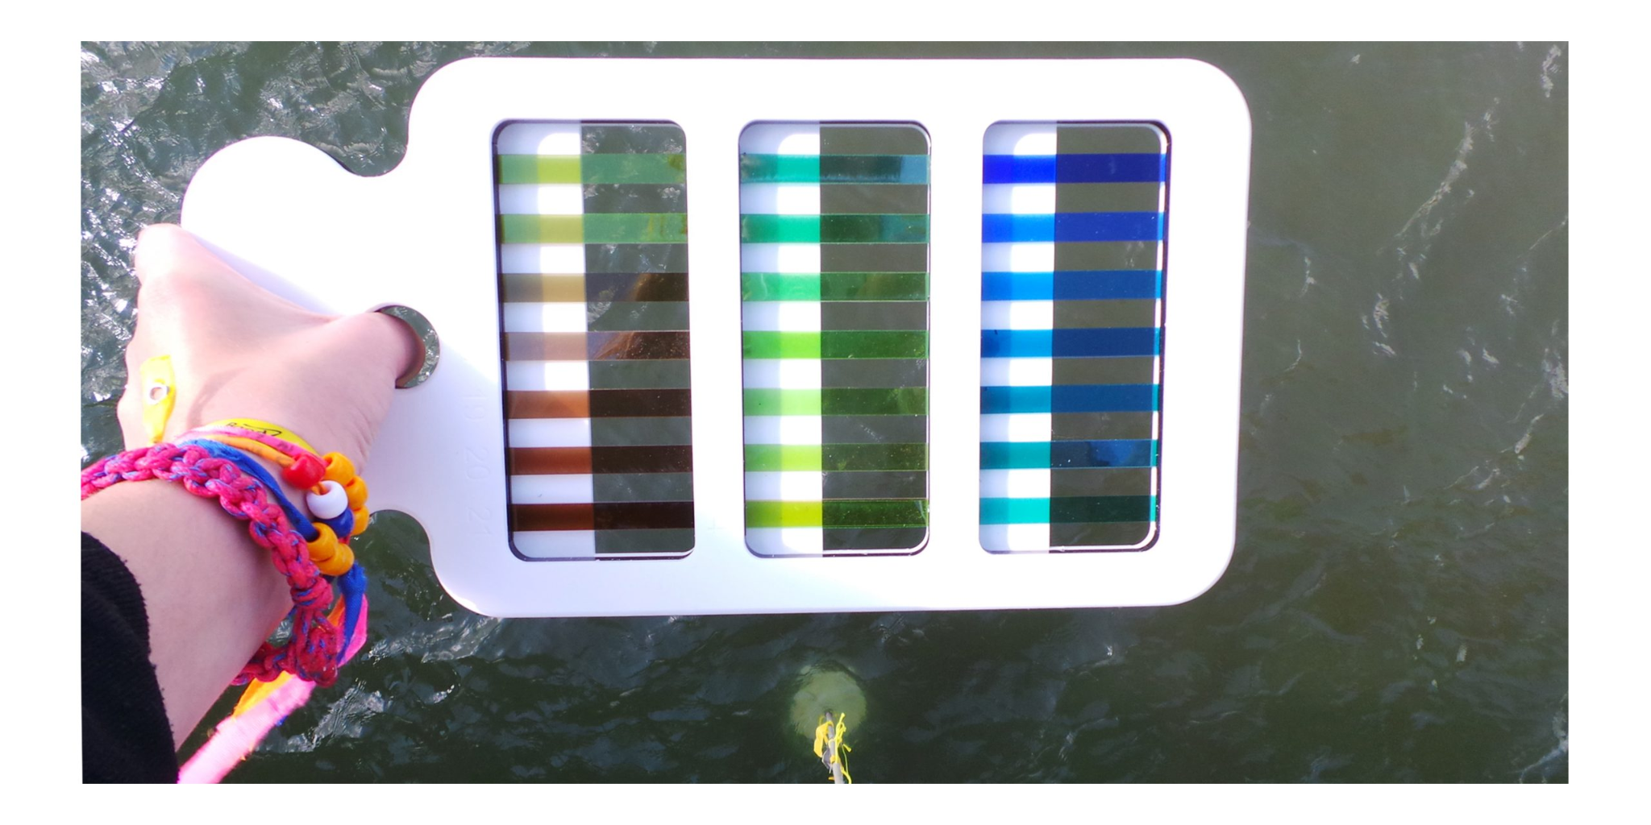
Limnology Defined
Derived from Greek word “limnos”, which means lake
Limnology is the study of lakes, river, and wetlands as systems (Kalff 2002)
… the oceanography of lakes (Forel 1800s)
… the study of the functional relationships and productivity of freshwater communities as they are regulated by their physical, chemical, and biological environments (Wetzel 2001).

Slide 4
Limnology
Biology
Physics
Chemistry
Geology
Limnology is integrative and interdisciplinary

Slide 5
Aspects of limnology
Hydrogeology – lake formation, climate
Physics – thermal regime, hydrodynamics/turbulence, stratification, particle settling/resuspension
Chemistry – pH, oxygen & redox, salinity, alkalinity, fertilizers & pollution
Biology – microbes, phytoplankton, zooplankton, fishes

Slide 6
Kalff's Limnology
Chapter 1 – What is limnology?
Chapter 2 – Who are these people?
Chapter 3 – Water is weird

Slide 7
Kalff's Limnology
Chapter 1 – What is limnology?
Chapter 2 – Who are these people?

Slide 8
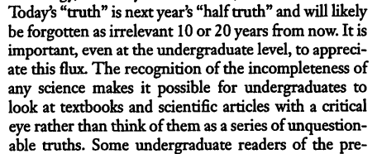

Slide 9
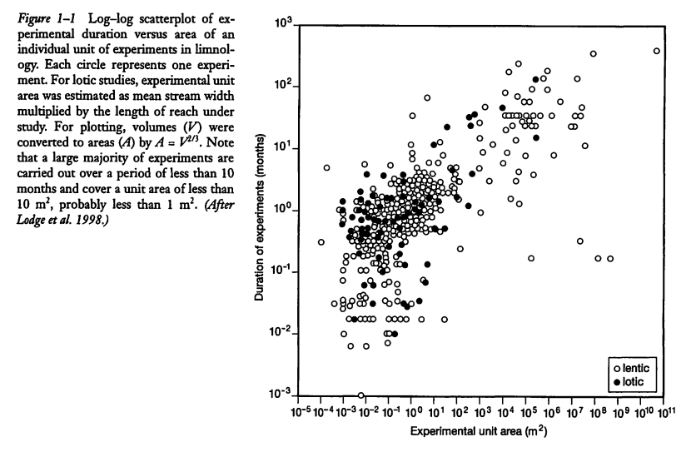

Slide 10
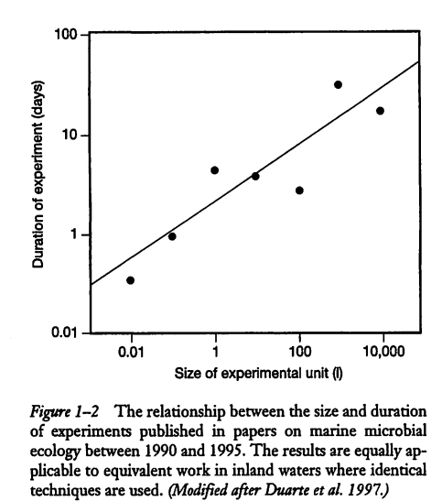
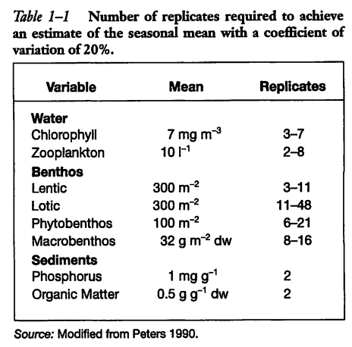

Slide 11
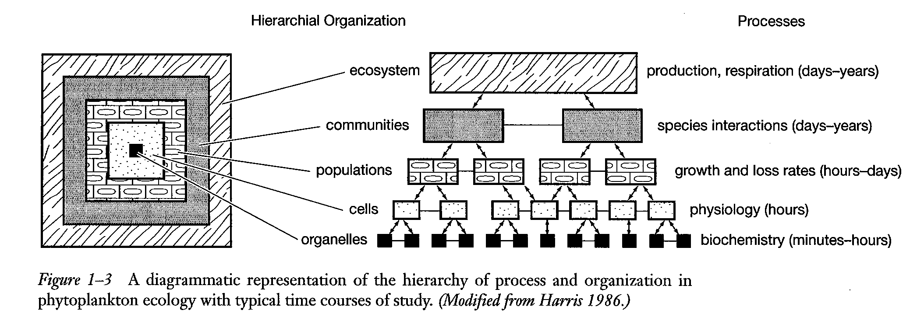
Hierarchy

Slide 12
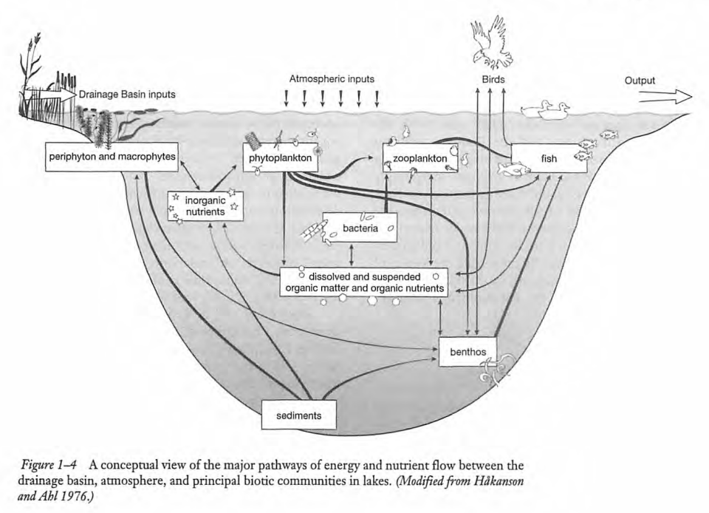

Slide 13
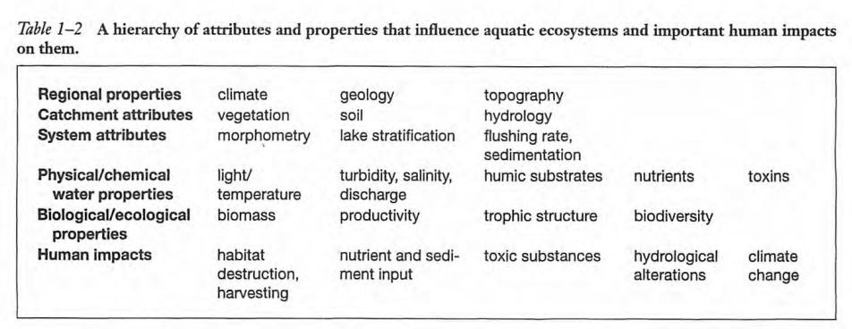

Slide 14
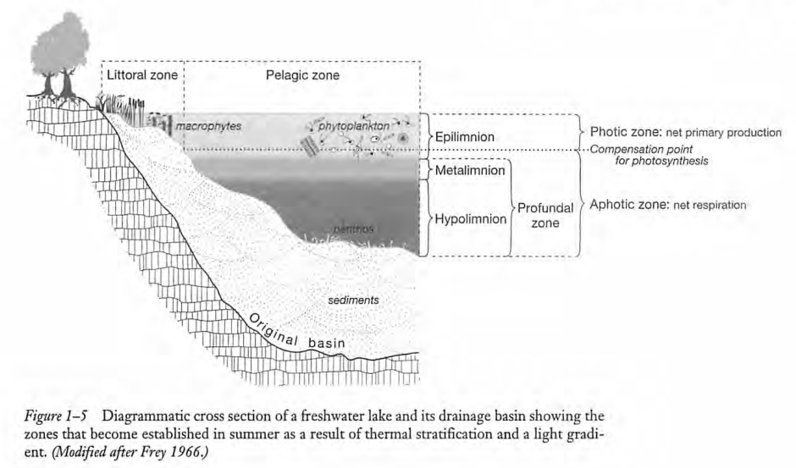

Slide 15
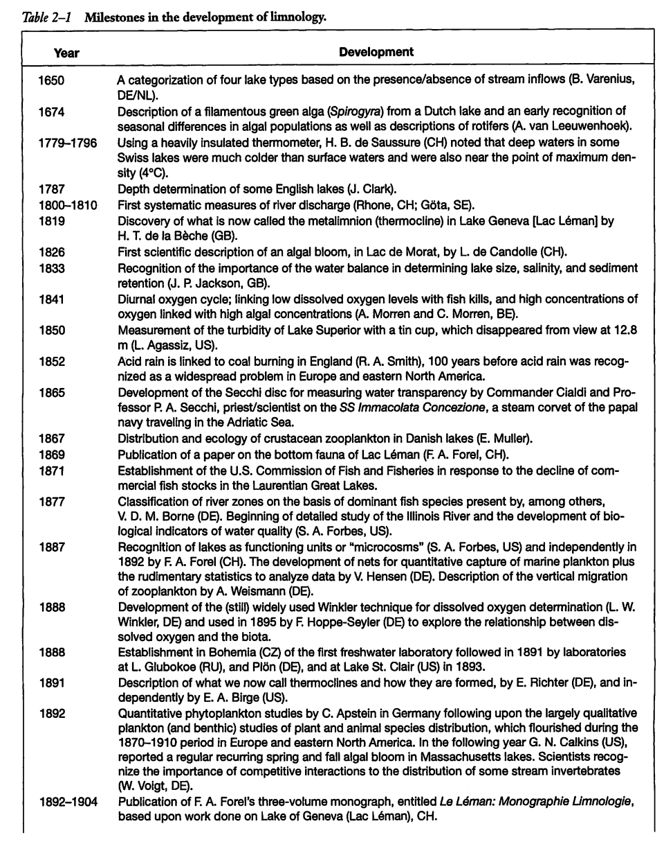

Slide 16
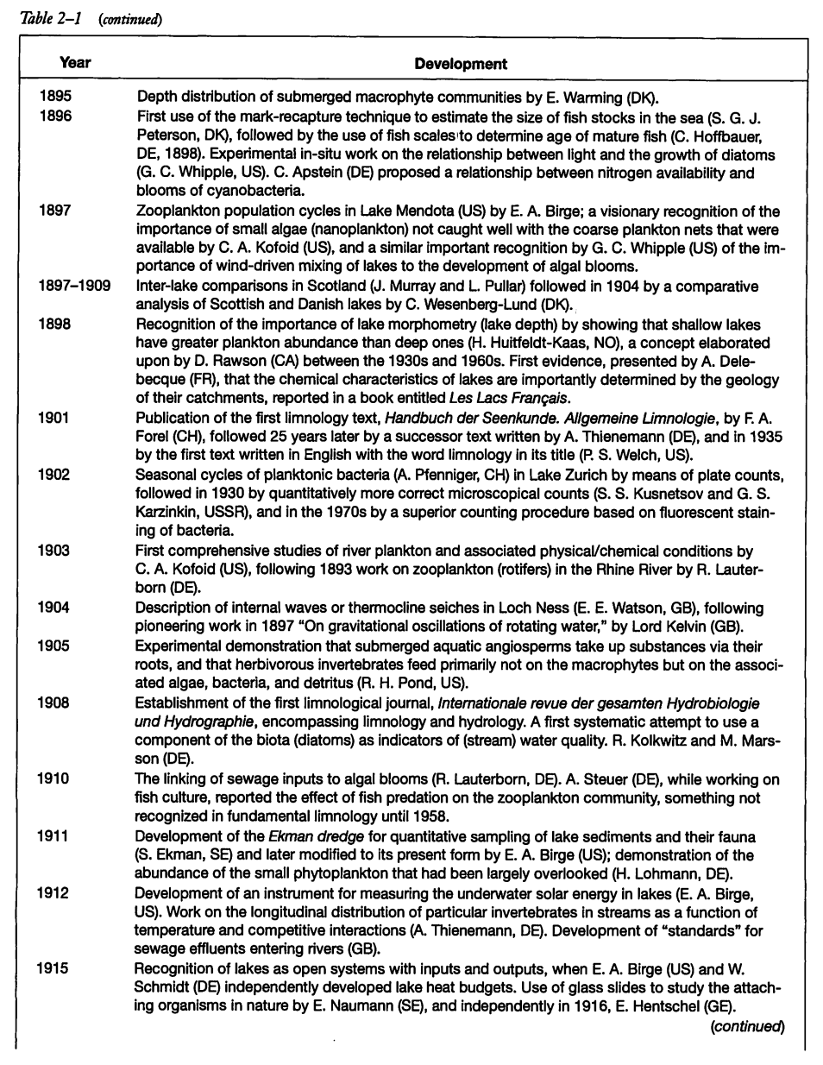

Slide 17
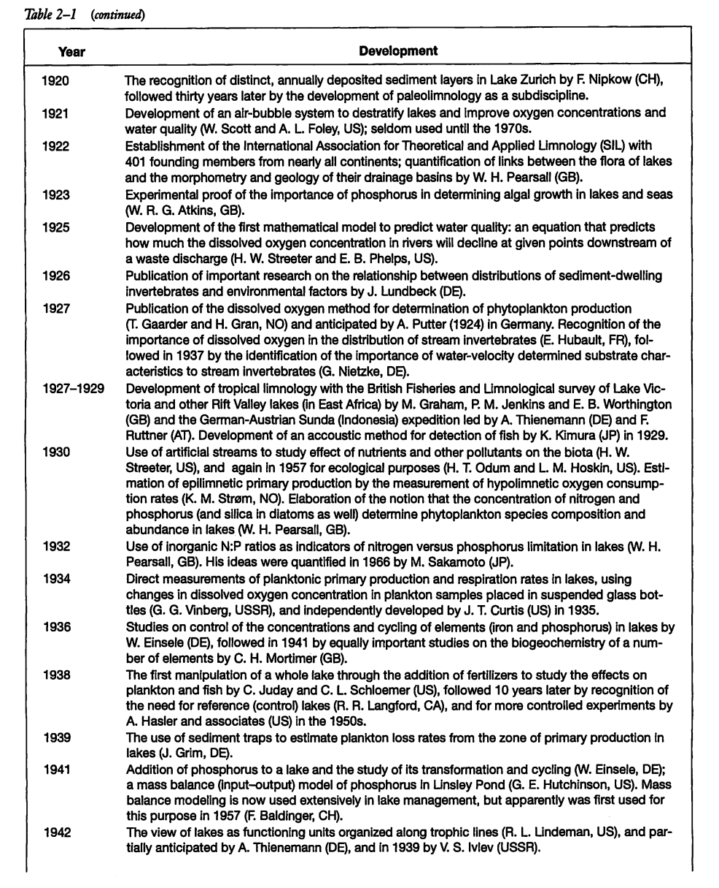

Slide 18
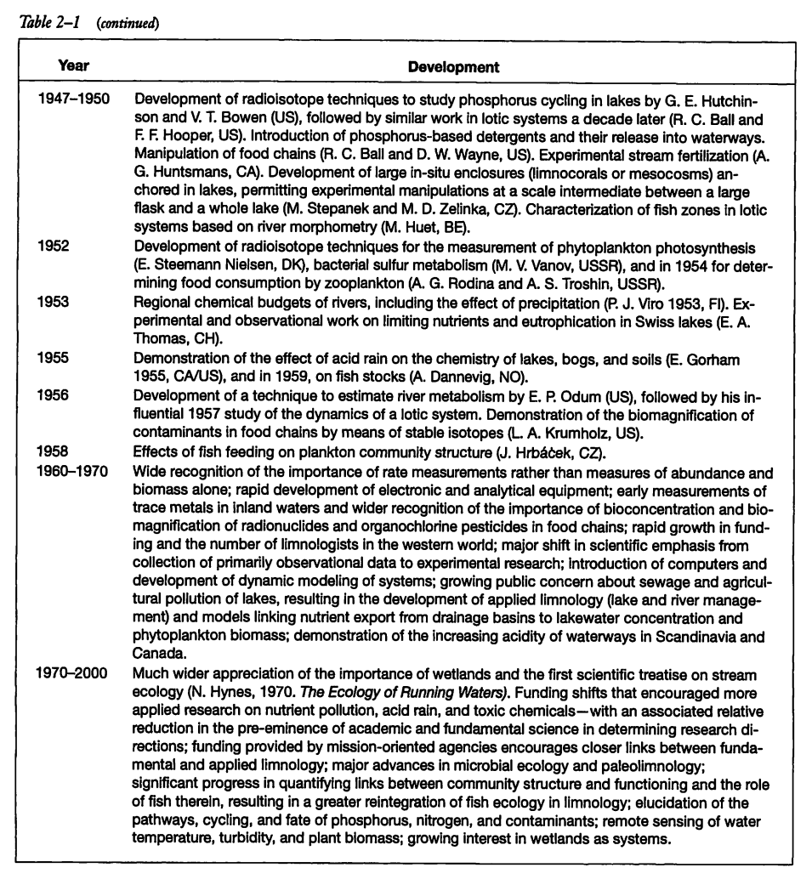

Slide 19
What is scale?

Slide 20
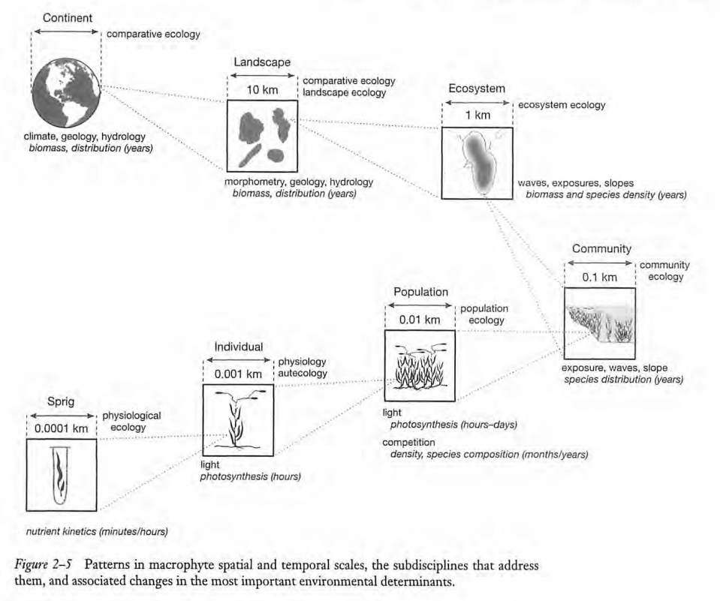

Slide 21
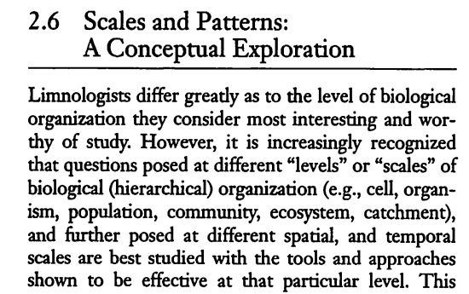

Slide 22
Consider growth rates of organisms:
How does doubling time scale with organism size?

Slide 23
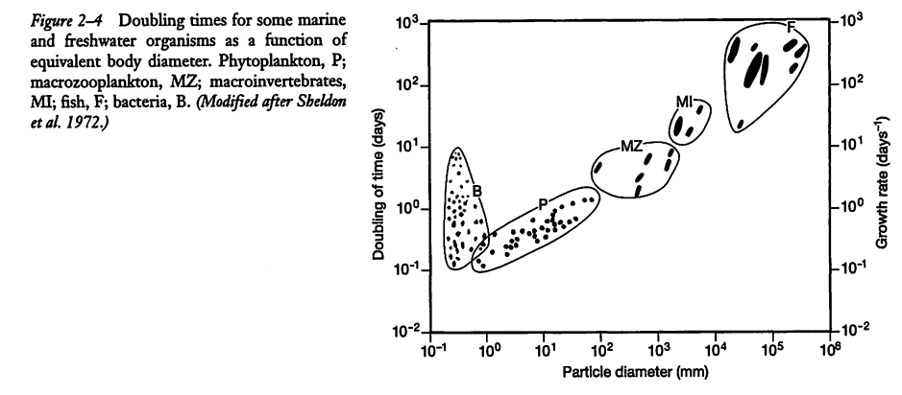

Slide 24
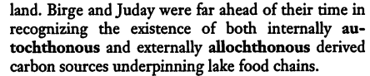

Slide 25
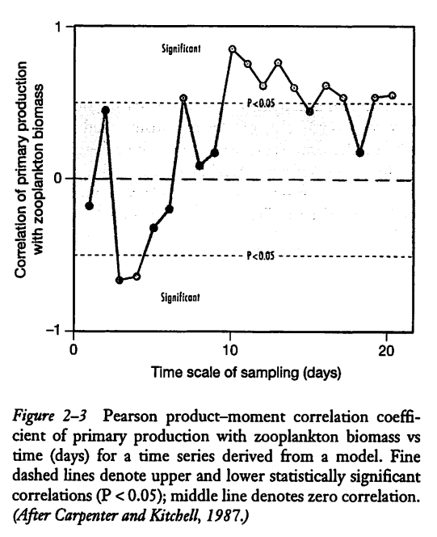

Slide 26


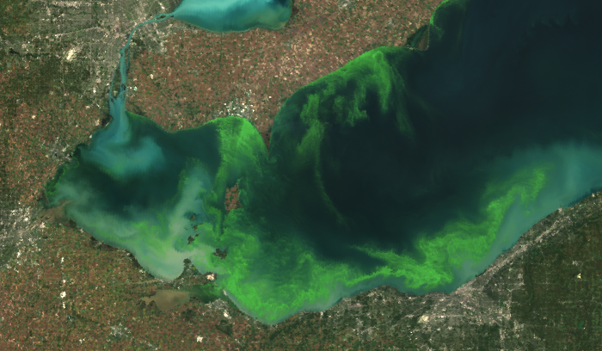
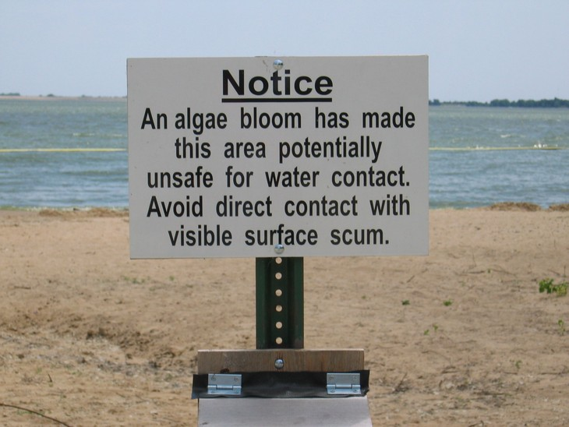
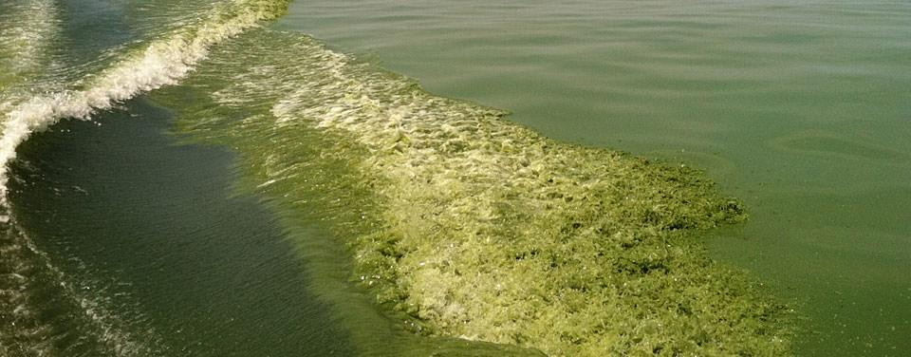

Slide 27
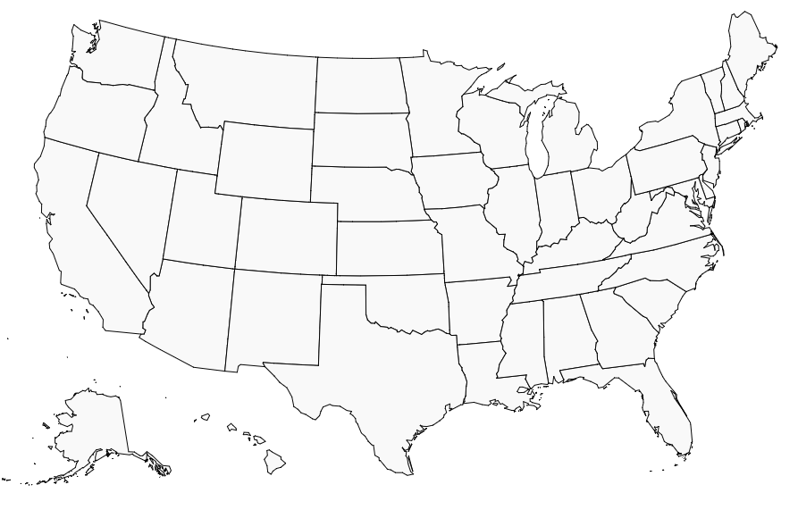



Early Limnology in the United States
Birge and Juday
1876-1944
Welch
1918-1959
Hutchinson
1928-1975

Slide 28
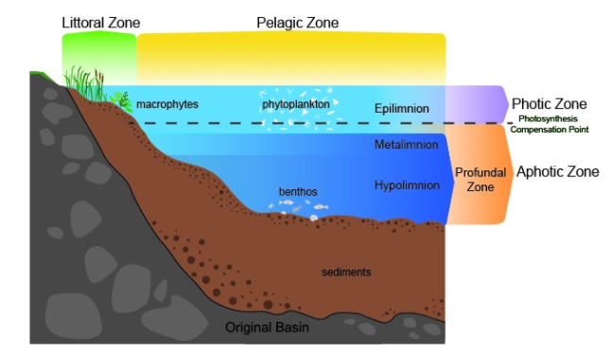
Some limnological terms:

Slide 29
Some limnological terms:
Lotic- running water
Lentic - standing water
Limnology deals with both fresh and saltwater (Great Salt Lake, Mono Lake, Salton Sea)
allochthonous- organic matter coming into a lake/river from terrestrial environment (soil, detritus, leaves, wood)
autochonous- organic matter produced within the lake/river (algae, diatoms, cyanobacteria)

Slide 31
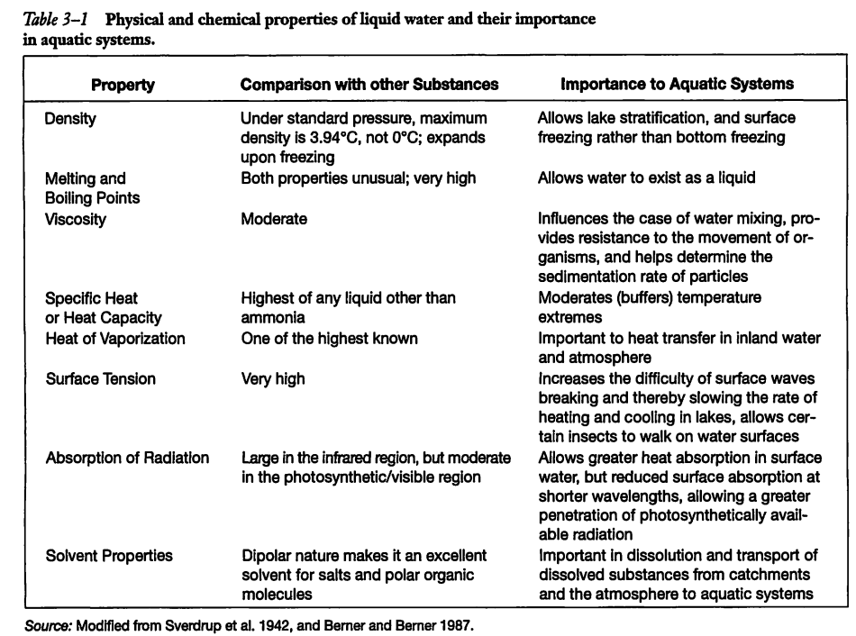
Important and unique characteristics of H₂O

Slide 32
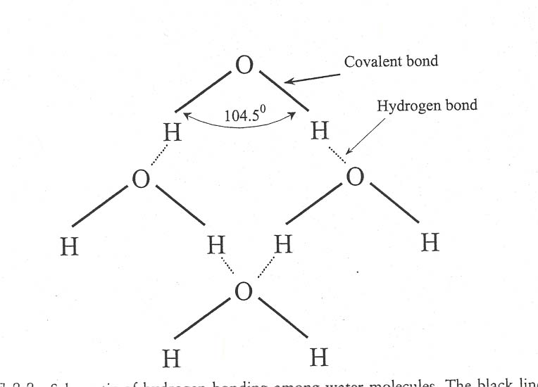
Molecular structure
Asymmetric covalent bonds yields polarity (i.e. dipole moment) due to electronegativity difference between O and H.
Dipole moment leads to H-bonding and many unique properties of water:
Much energy required or given off in phase transitions
Large heat storage capacity
Unique aspects of surface tension and density

Slide 33
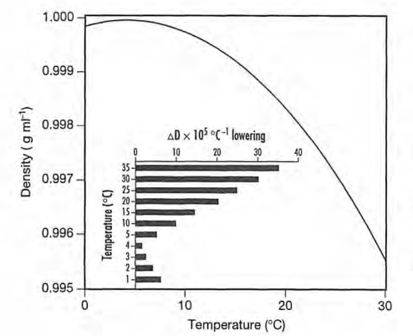
Water density as function of temperature

Slide 34
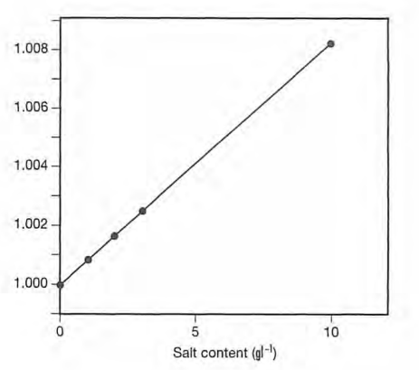
Water density and salinity

Slide 35
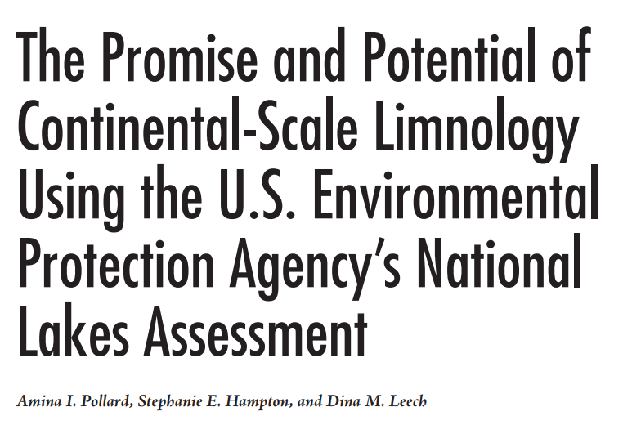


Slide 36
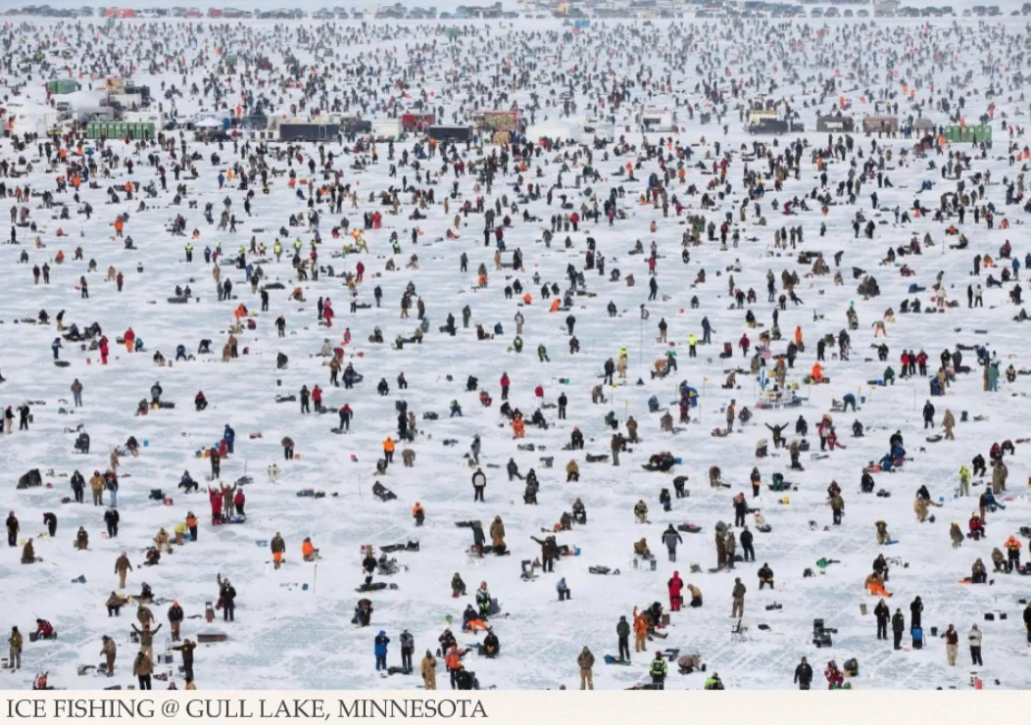

Slide 37
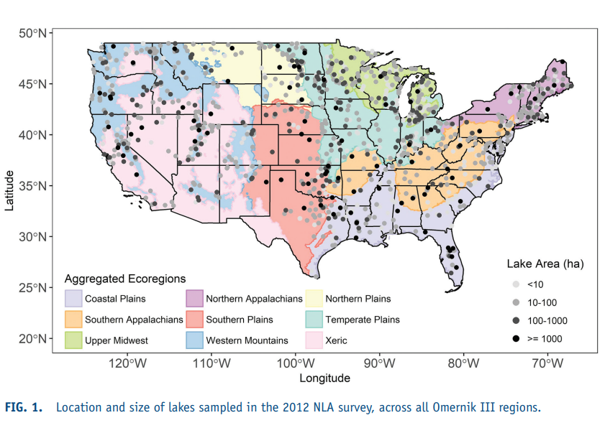
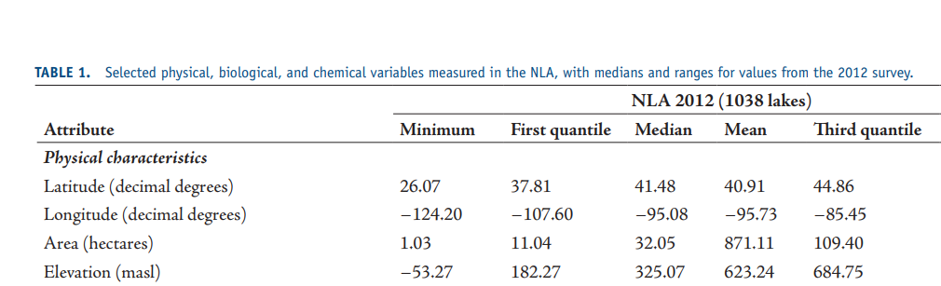
Exercises in Data

Slide 38
Exercises in Data
How does lake surface area vary between regions, and with latitude and longitude?
Describe the mathematical relationship between lake surface area and depth.
How do the answers differ for naturally formed vs. artificial lakes (reservoirs) ?

Slide 40


Slide 41
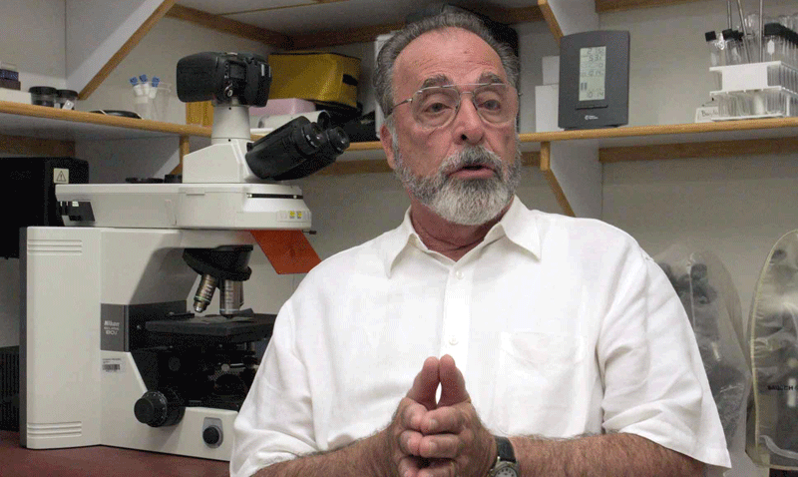
Owen Lind - “The father of Baylor Limnology”
Baylor Limnology – A 50 year history
Lind, O.T., & R.S. Campbell. 1969. On the use of liquid scintillation for routine 14C determination in production studies. Limnology and Oceanography 14: 787-789.
Jacobs, R., & O.T. Lind. 1977. The combined relationship of temperature and molybdenum concentration on nitrogen fixation by Anabaena cylindrica. Microbial Ecology 3: 205-217.
Lind, O.T. 1987. Spatial and temporal variation in hypolimnetic oxygen deficits of a multidepression lake. Limnology and Oceanography 32: 740-744.
Lind, O.T., R.D. Doyle, D.S. Vodopich, B.G. Trotter, J. Gualberto Limon, & L. Davalos-Lind. 1992. Clay turbidity: Regulation of phytoplankton production in a large, nutrient-rich tropical lake. Limnology and Oceanography 37: 549-565.
Lind, O.T., T.H. Chrzanowski, & L. Davalos-Lind. 1997. Clay turbidity and the relative production of bacterioplankton and phytoplankton. Hydrobiologia 353: 1-18.
Christian, B.W., & O.T. Lind. 2007. Increased sediment-water interface bacterial [3H]-L-serine uptake and biomass production in a eutrophic reservoir during summer stratification. Fundamental and Applied Limnology 168: 189-199.
Lind, O.T., L. Davalos-Lind, C. Lopez, M. Lopez, and J. Dyble Bressie. 2016. Seasonal morphological variability in an in situ Cyanobacteria monoculture: example from a persistent Cylidrospermopsis bloom in Lake Catemaco, Veracruz, Mexico. Journal of Limnology 75: 66-80.

Slide 42
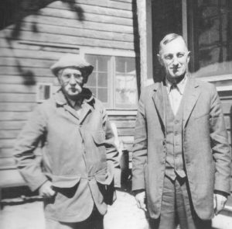
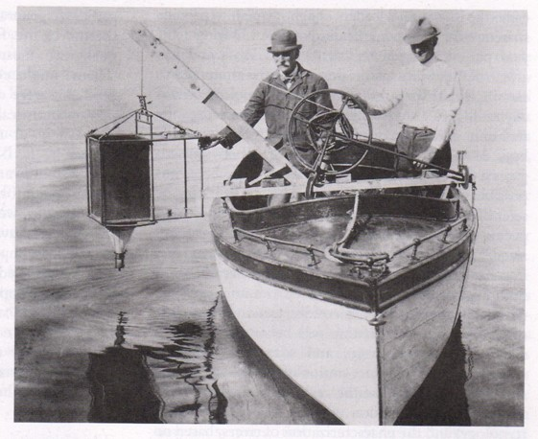
Birge and Juday – University of Wisconsin
Discovered:
The thermocline (1891)
Zooplankton population cycles (1897)
Developed underwater light meter (1912)
Lakes as ‘open’ systems (1915)
Founded:
Trout Lake Biological Station

Slide 43
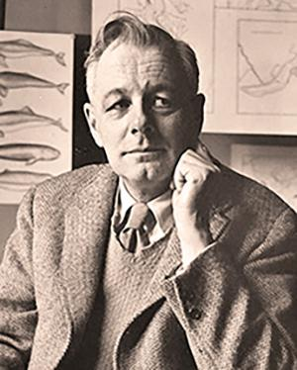
G.E. Hutchinson – Quantitation
A Treatise on Limnology
4 volume text:
1957
1967
1975
1993 (posthumus)
Paradox of the plankton
The Ecological Theater and the
Evolutionary Play
Bioenergetics
Niche-theory

Slide 44
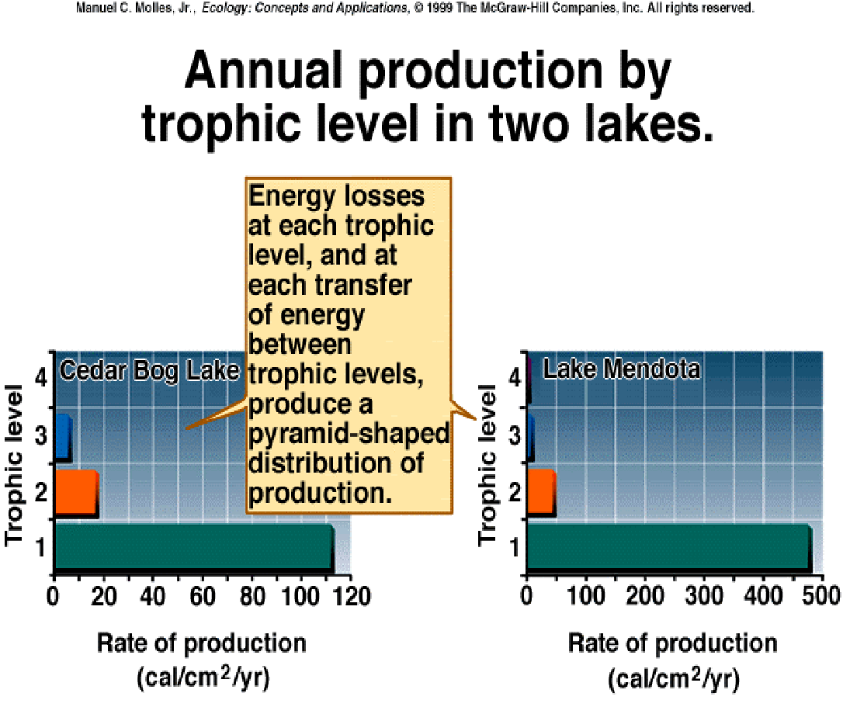
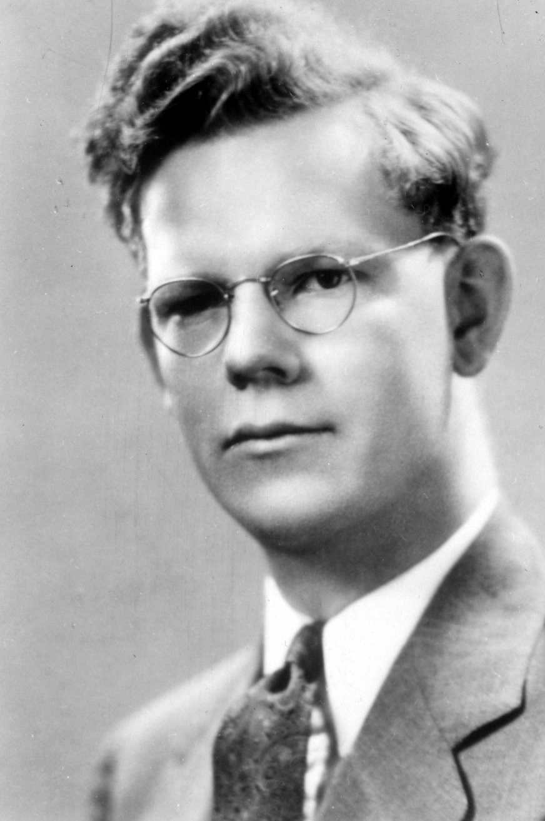
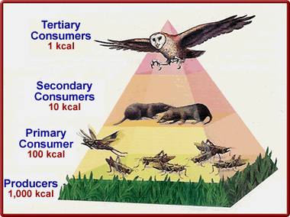
27 year old Raymond Lindeman- Trophic dynamic aspect of ecology
Quantified bioenergetics of Cedar Bog Lake
Established the 10% rule of trophic transfer efficiency

Slide 45
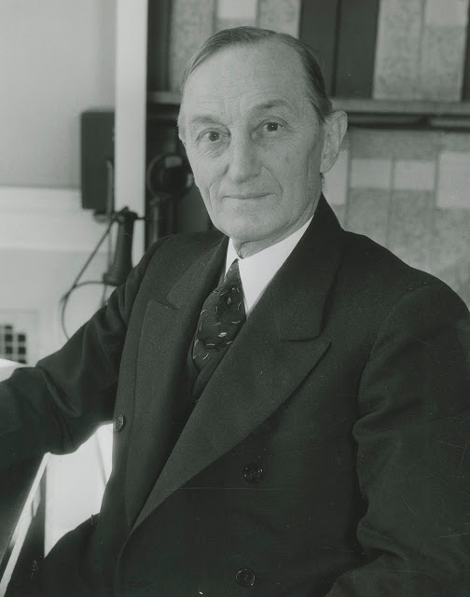
27 year old Raymond Lindeman- Trophic dynamic aspect of ecology
“…According to our experiences, lakes are ‘rank individualists’ and are very stubborn about fitting into mathematical formulae and artificial schemes proposed by man.... Some of the broad generalizations men- tioned in the paper are certainly very broad; so broad in fact that they cannot be regarded as having much value…”
Juday’s Review:
Reject

Slide 46
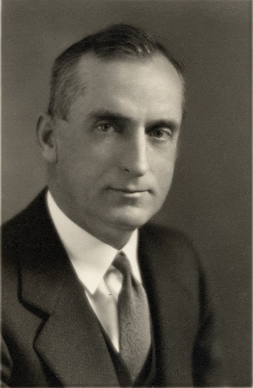
27 year old Raymond Lindeman- Trophic dynamic aspect of ecology
“… Limnology is not yet ready for generalizations of this kind. The basic background data for such a paper is far too fragmentary. If Dr. Lindeman could put this paper aside for ten years, then bring it out and see how it looks in the light of what we hope will be the added accumulation of limnological information, he might possibly congratulate himself that he deferred its publication… ”
Welch’s Review:
Reject

Slide 47
Raymond Lindeman- Trophic dynamic aspect of ecology
" May I suggest that you commu- nicate to the referees (I think that internal stylistic peculiarities reveal their identity as men for whom I have great personal regard and who have been most kind to me on many occasions) this letter, except for the preceding sentence, that they may realize that most of the specific points challenged are matters for which I, rather than Lindeman, am responsible.
Hutchinson’s Support
. . .The second part of criticism 3 of Referee 1 and the comments of Referee 2 virtually reduce to a discussion of a) whether theoretical work is legitimate in ecology, and b) whether Ecology should print it. My own feelings, quite apart from Lindeman's paper, are that such a theoretical study is very desirable and that Ecology should cover the whole field of the subject.”

Slide 48
Raymond Lindeman- Trophic dynamic aspect of ecology
Accepted!! Published in Ecology in 1942 (not your typical year)
Just a few weeks before the paper was published, Lindeman passed of gastrointestinal disease at age 27

Slide 50
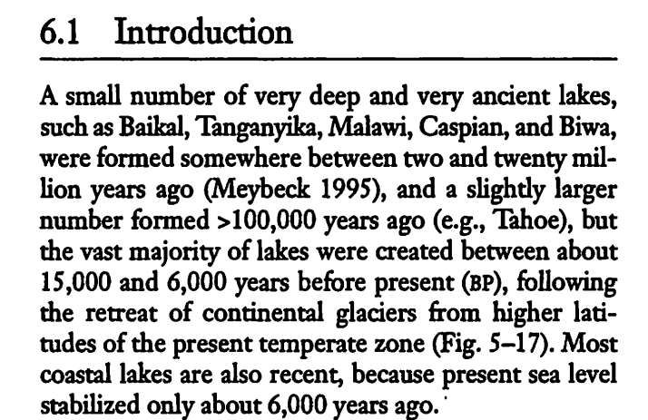
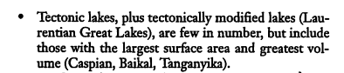

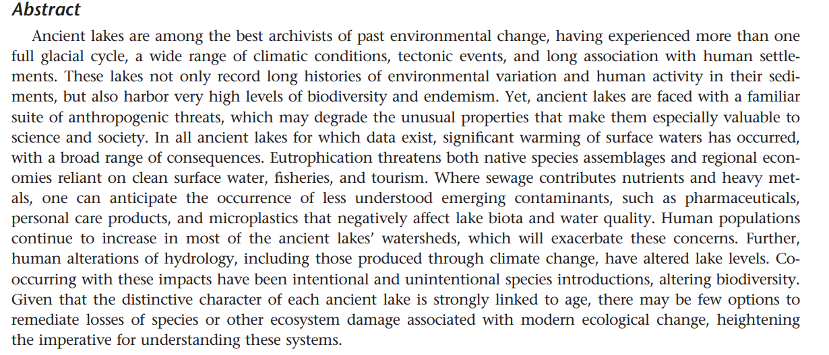

Slide 51
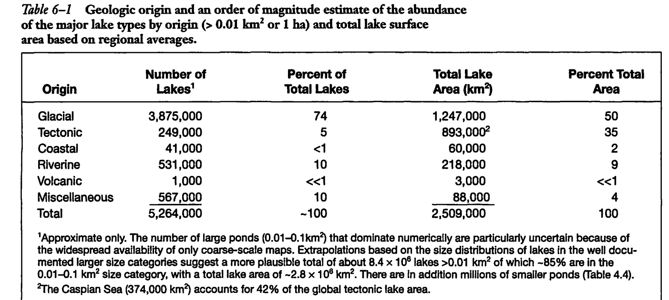

Slide 52
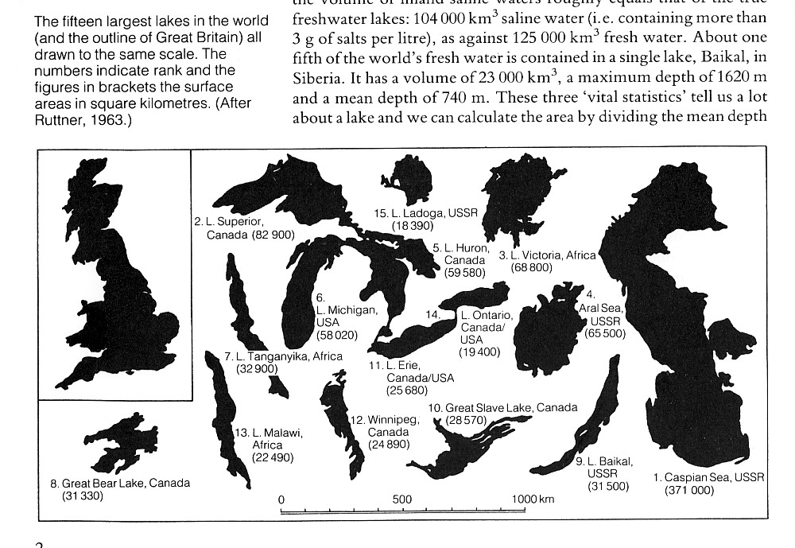
Most water is in a few very large basins
Burgis and Morris 1987
Deepest, most voluminous

Slide 53
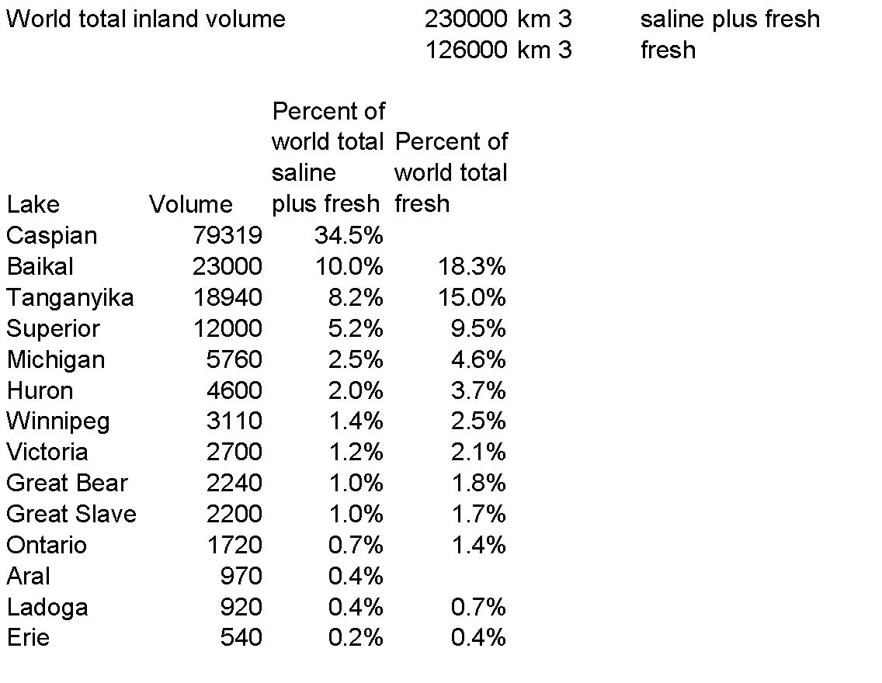
Volumes of lakes on previous slide
A large fraction of global surficial freshwater is in a few large lakes.
These represent 62% of global freshwater

Slide 54
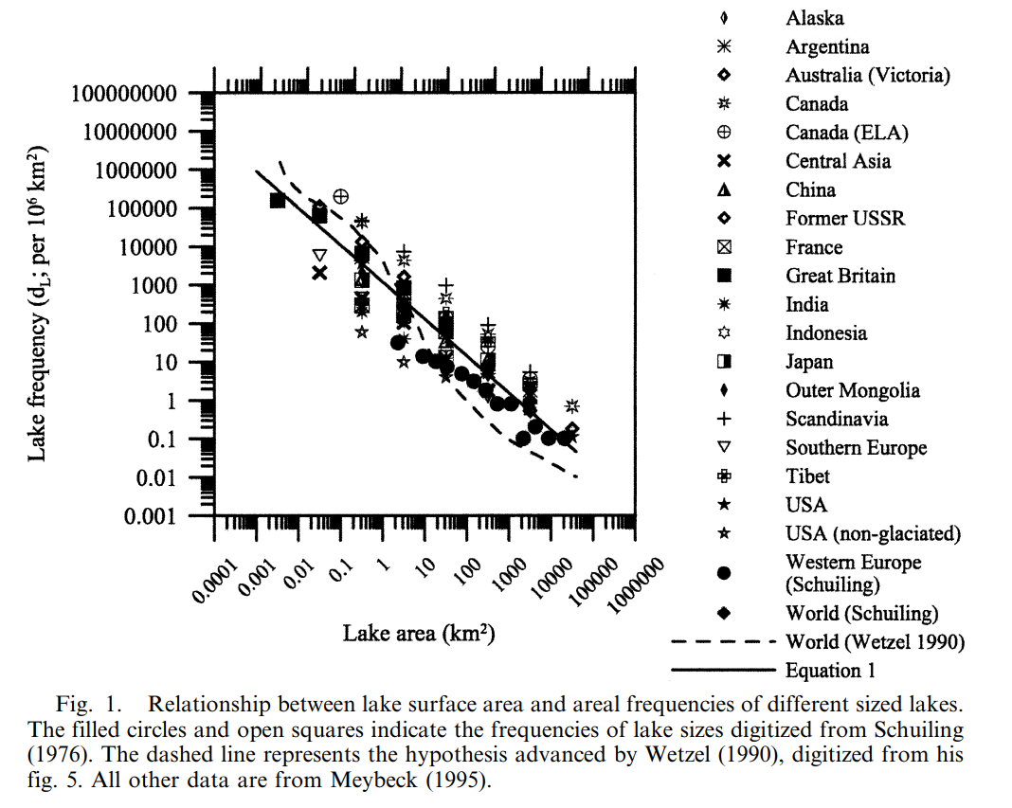

Most lakes are small

Slide 55
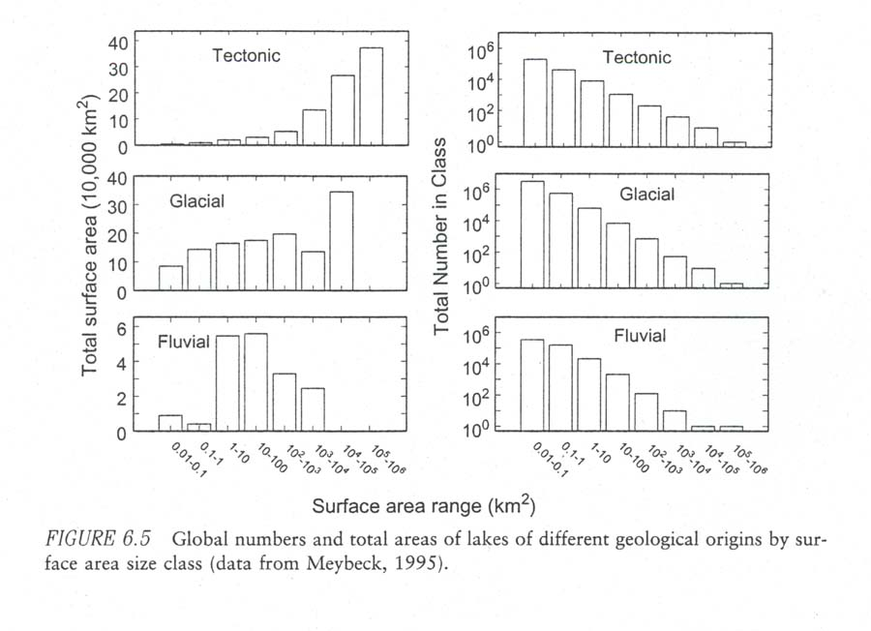

Slide 56

Lake morphometry

Slide 57
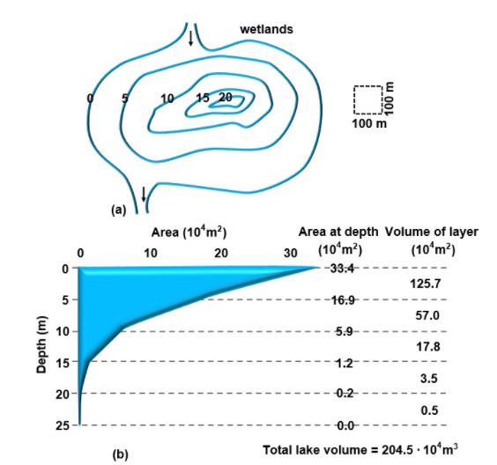
Lake Bathymetry

Slide 58



Hypsographic curves

Slide 59

Hypsographic curves
Absolute
hypsographic curve
Relative
hypsographic curve

Slide 60

Hutchinson GE (1957) A Treatise on Limnology. I. Lake Geography, Physics, and Chemistry, Vol. John Wiley, New York, NY

Slide 61


Hutchinson GE (1957) A Treatise on Limnology. I. Lake Geography, Physics, and Chemistry, Vol. John Wiley, New York, NY

Slide 62

Reservoirs
Deepest near dam
Highly dendritic
Big watersheds
Extensive shallows
(note flood pool)
“isopleths” contours of equal depth
Sterner RW (1994) Seasonal and spatial patterns in macro and micro nutrient limitation in Joe Pool Lake, Texas. Limnology and Oceanography 39:535-550

Slide 64

Reservoir
Limnology

Slide 65

Components of Dams:

Slide 66

Types of Dams:
Gravity concrete dam – solid concrete that uses mass to hold back water
Gravity w/ Buttresses – triangular supports on the downstream face that distribute water pressure to the dam foundation
Concrete Arch dam – concave design into reservoir to strengthen dam
Earthen Embankment dam – more than 50% of volume of dam is made from compacted earth materials
MANY DAMS ARE A COMBINATION OF THESE VARIOUS DESIGNS

Slide 67




Hoover Dam and Lake Mead:

Slide 68

FIGURE 7.9
Bathymetric maps of Belton Reservoir, Texas (left), and Flathead Lake, Montana (right). The reservoir is dendritic
and shallow, with the deepest portion near the dam (lower right). Flathead Lake was formed by a combination of
tectonic and glacial processes and is deep with a regular shoreline and shallow outlet (lower left).

Slide 69

Reservoir zonation
From Thornton et al. 1990

Slide 70

Reservoir zonation
From Thornton et al. 1990

Slide 71


Why do people build dams?
Dams are a fundamental management tool to control, regulate, and deliver surface water for a variety of purposes

Slide 72


Why do people build dams?
Dams are a fundamental management tool to control, regulate, and deliver surface water for a variety of purposes

Slide 73
U.S. National Inventory of Dams
https://nid.sec.usace.army.mil/#/
Criteria for inclusion in inventory:
1) High hazard classification - loss of one human life is likely if the dam fails,
2) Significant hazard classification - possible loss of human life and likely significant property or environmental destruction,
3) Equal or exceed 25 feet in height and exceed 15 acre-feet in storage,
4) Equal or exceed 50 acre-feet storage and exceed 6 feet in height.

Slide 74


http://nhd.usgs.gov/
2965 / 10⁶ km² =
0.02 per km²

Slide 75



Impacts of Dams
Fish migration

Slide 76



Navigation through Locks and Dams

Slide 77

From Thornton et al. 1990

Slide 78

From Thornton et al. 1990

Slide 79

Who are these people?
What hypotheses about lakes and reservoirs does this article touch on?
What potential hypotheses about lakes and reservoirs does this article generate in your mind?
What did you find to be most or least useful about this article?

